Slide 1
Deep Learning for Medical Researchers
Sam Green and
Prof. Çetin Kaya Koç

Slide 2
Last time
Introduced deep neural networks

Slide 3
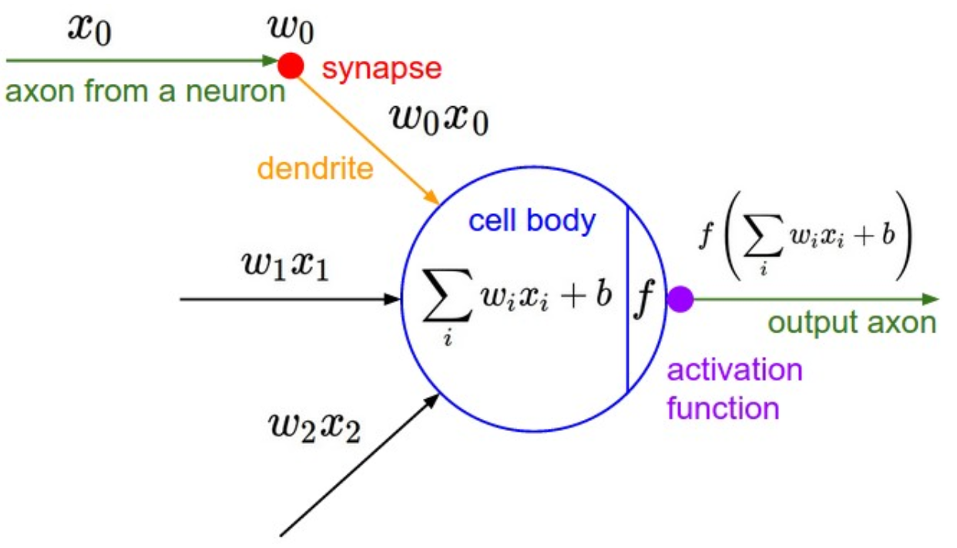
McCulloch-Pitts Neuron
http://cs231n.github.io/neural-networks-1/

Slide 4
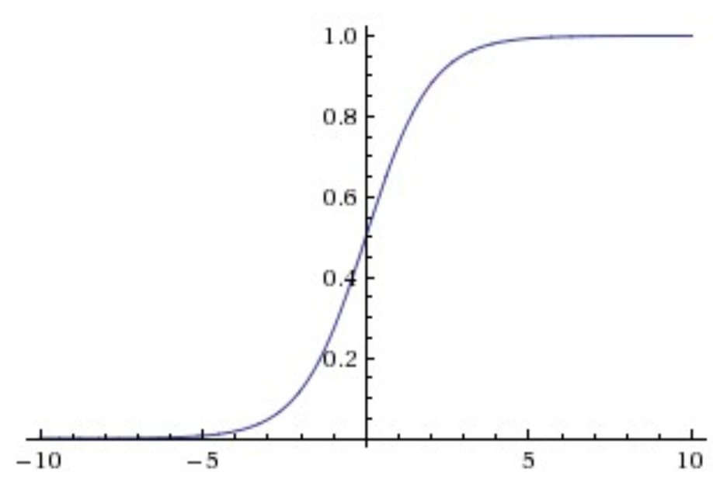
Activation function is nonlinear
http://cs231n.github.io/neural-networks-1/

Slide 5
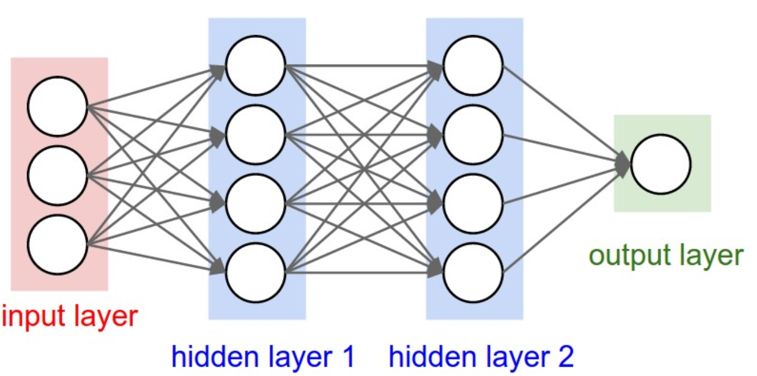
Multi-Layer Perceptron Technically a deep neural network (DNN)
http://cs231n.github.io/neural-networks-1/

Slide 6
Today
Python coding
Basic ML tasks
Classification
Regression
scikit-learn

Slide 7
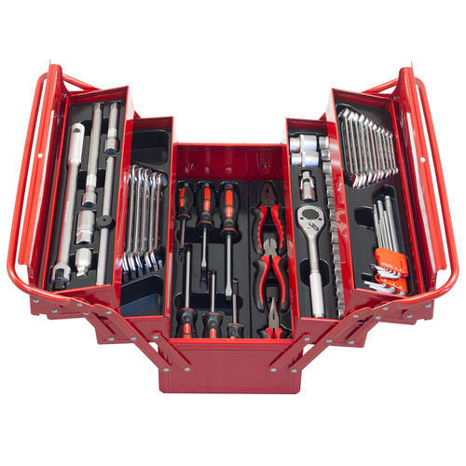

Deep learning is only one of many ML algorithms
Deep Learning
Machine Learning

Slide 8
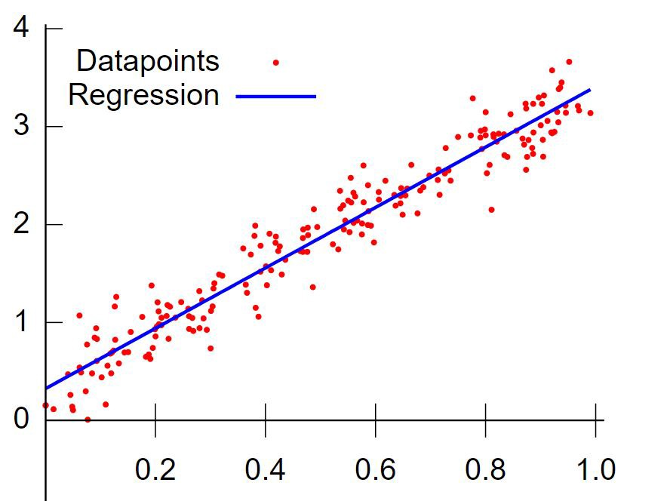
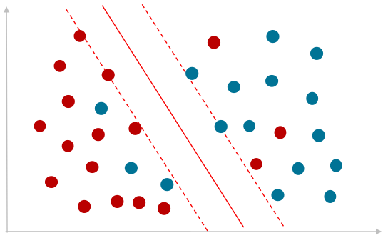
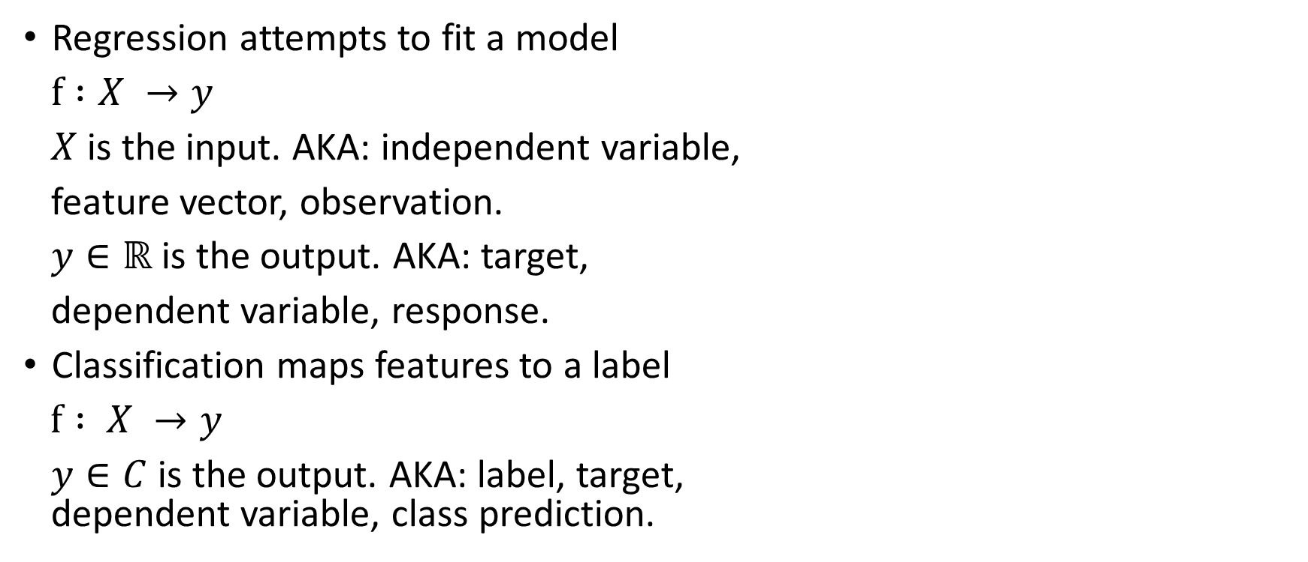
Regression and Classification
Regression attempts to fit a model
$f :X →y$
$X$ is the input. AKA: independent variable,
feature vector, observation.
$y∈ℝ$ is the output. AKA: target,
dependent variable, response.
Classification maps features to a label
$f : X →y$
$y∈C$ is the output. AKA: label, target, dependent variable, class prediction.
Image credit: https://blogs.oracle.com
Image credit: https://medium.com/deep-math-machine-learning-ai

Slide 9
Regression Examples
Predict housing prices
Inputs: number of rooms, number of bathrooms sq. meters
Output: price
Predict lifespan
Inputs: number of hours exercise per week, smoker, country, great grand parents’ age
Output: age

Slide 10
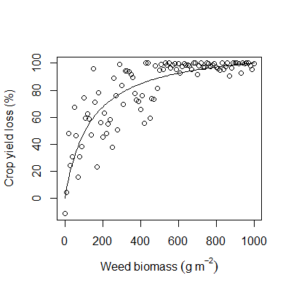
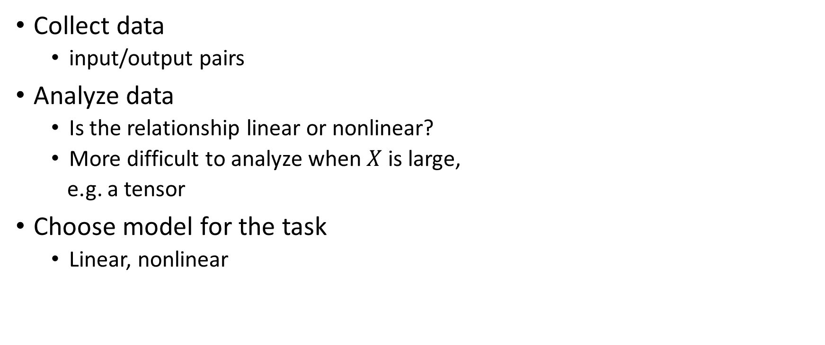
Regression training
Collect data
input/output pairs
Analyze data
Is the relationship linear or nonlinear?
More difficult to analyze when $X$ is large,
e.g. a tensor
Choose model for the task
Linear, nonlinear

Slide 11
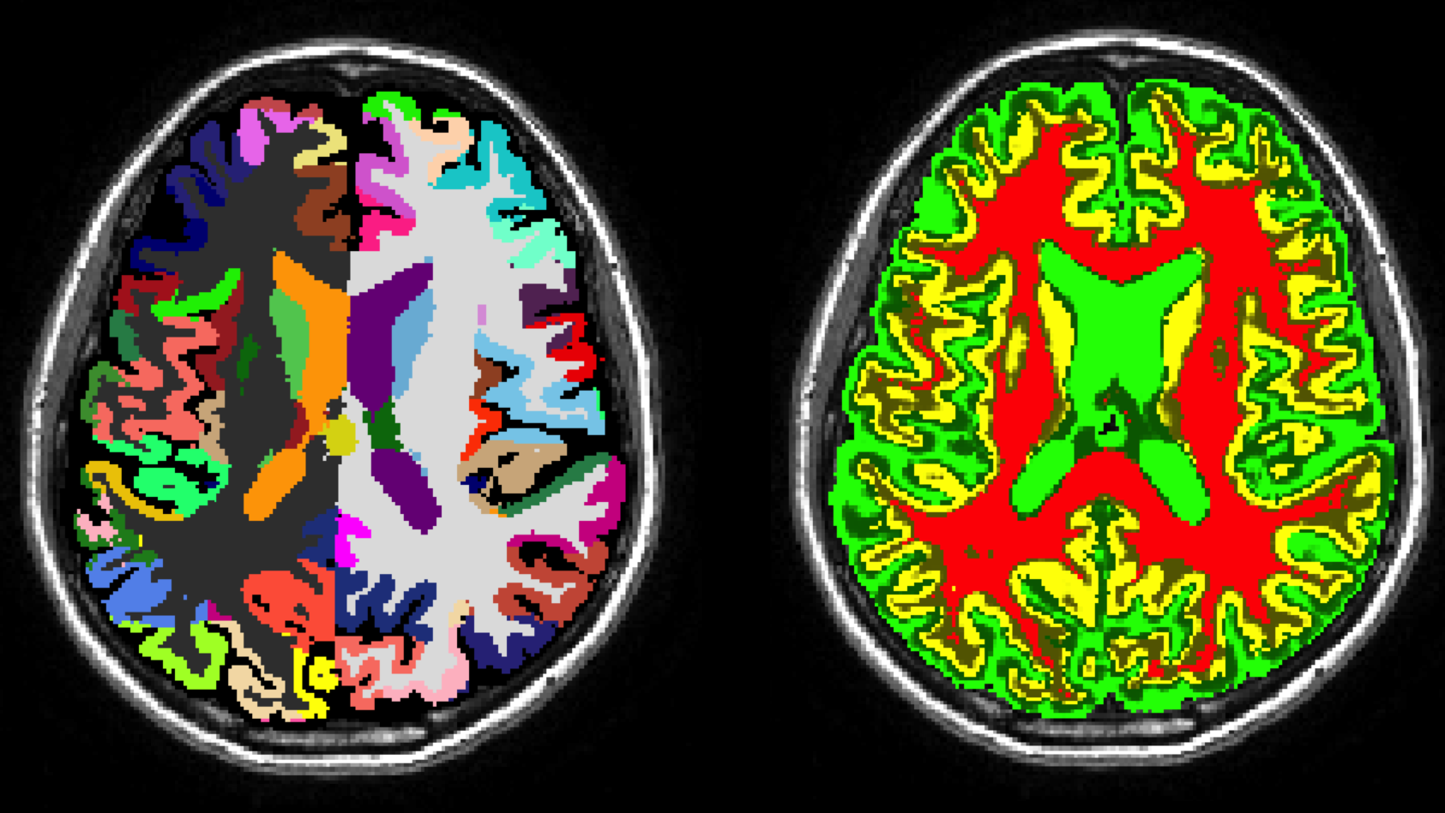
Classification Examples
Predict if house in high or low crime area
Predict student future occupation
Given an x-ray, diagnose type of condition
Segment medical image according to tissue type
Image credit: http://niftyweb.cs.ucl.ac.uk/

Slide 12
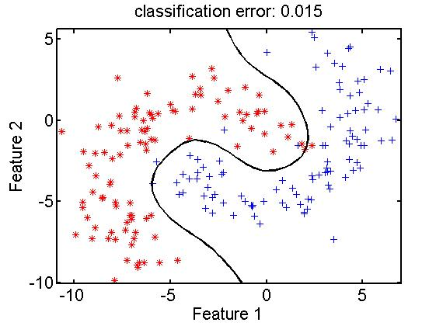
Classifier training
Collect data
input/output pairs
Analyze data
Is the relationship linear or nonlinear?
More difficult to analyze when $X$ is large,
e.g. a tensor
Choose model for the task
Linear, nonlinear

Slide 13
Scikit-learn
Python package for machine learning
Mature documentation and lots of help online
http://scikit-learn.org/stable/
Linear regression Colab example
Classification Colab example

Slide 14
Recent progress: modeling nature
Deep learning models reveal internal structure and diverse computations in the retina under natural scenes
Inputs: natural scene images (video)
Training labels: measurements from ganglion cells
Test: compared model outputs to a separate retinae that the model was never fit to

Slide 15
